Slide 1
Data-Driven Insights on Pizza Sales Using SQL: Querying and Problem Solving
Presented by:- Ashwani Kumar

Slide 2
Introduction:
This analysis explores pizza sales data using SQL.
It involves key queries such as aggregations, joins,
and advanced techniques like window functions
(RANK(), SUM()), groupings, and ordering to uncover
insights and optimize sales strategies.

Slide 3
Data Set Used for Insights
The analysis utilizes interconnected tables: orders_details, pizzas, pizza_types, and orders. These tables provide data on orders, pizza categories, and revenue, enabling SQL-driven insights into sales trends, top-performing pizzas, and revenue contributions.

Slide 4
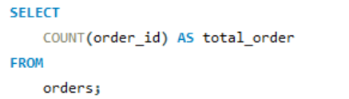

Retrieve the total number of orders placed.
Query:
Output:

Slide 5
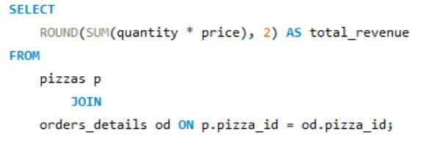

Calculate the total revenue generated from pizza sales.
Query:
Output:

Slide 6
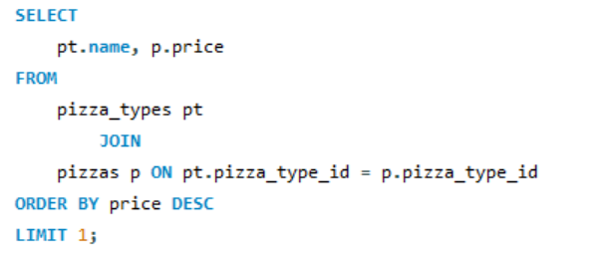

Identify the highest-priced pizza.
Query:
Output:

Slide 7
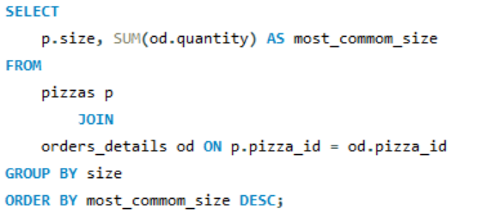
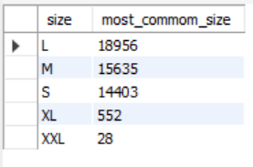
Identify the most common pizza size ordered.
Query:
Output:

Slide 8
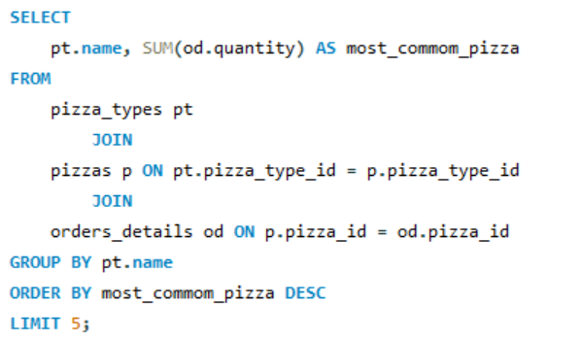
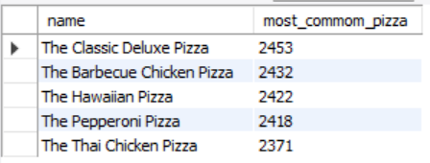
List the top 5 most ordered pizza types along with their quantities.
Query:
Output:

Slide 9
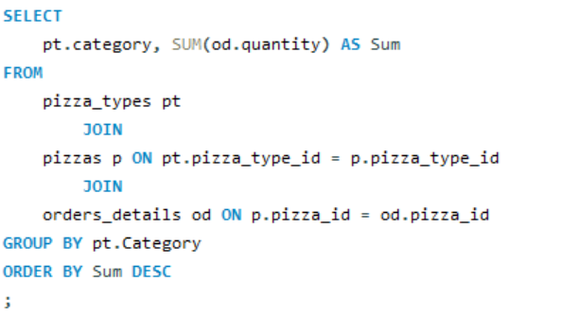
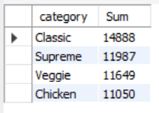
Join the necessary tables to find the total quantity of each pizza category ordered.
Query:
Output:

Slide 10
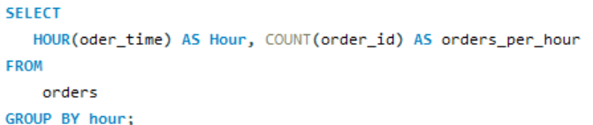
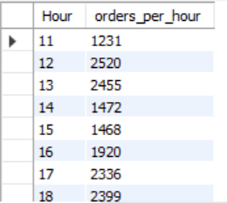
Determine the distribution of orders by hour of the day.
Query:
Output:

Slide 11
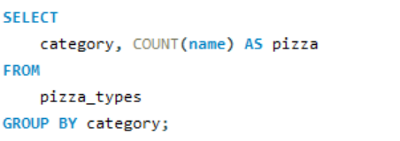
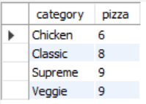
Join relevant tables to find the category-wise distribution of pizzas.
Query:
Output:

Slide 12
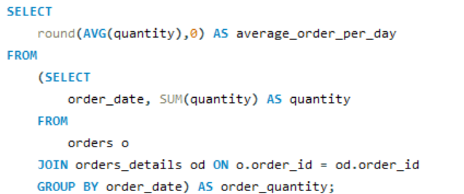

Group the orders by date and calculate the average number of pizzas ordered per day.
Query:
Output:

Slide 13
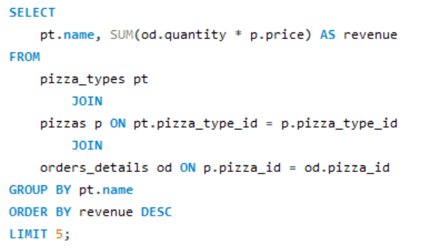
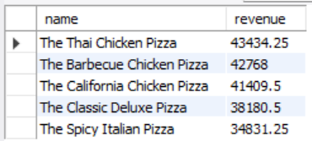
Determine the top 3 most ordered pizza types based on revenue.
Query:
Output:

Slide 14
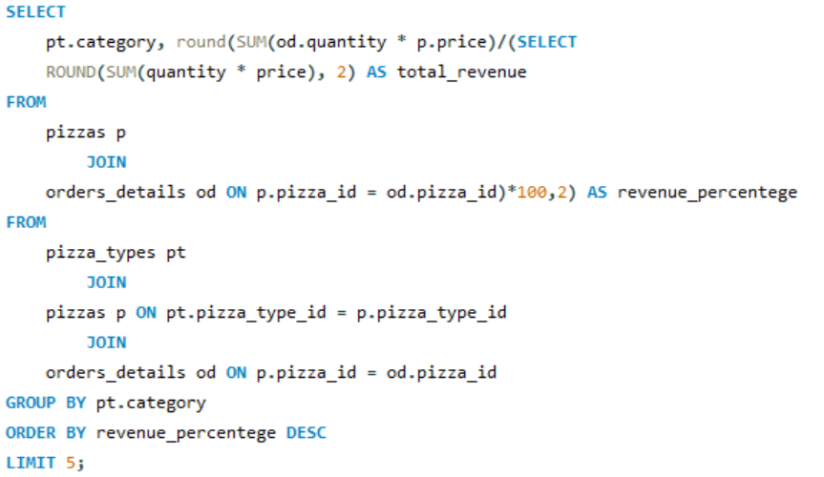
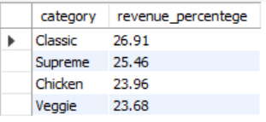
Calculate the percentage contribution of each pizza type to total revenue.
Query:
Output:

Slide 15
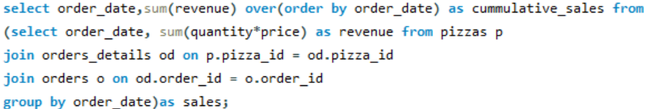
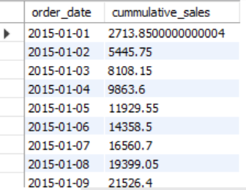
Analyze the cumulative revenue generated over time.
Query:
Output:

Slide 16
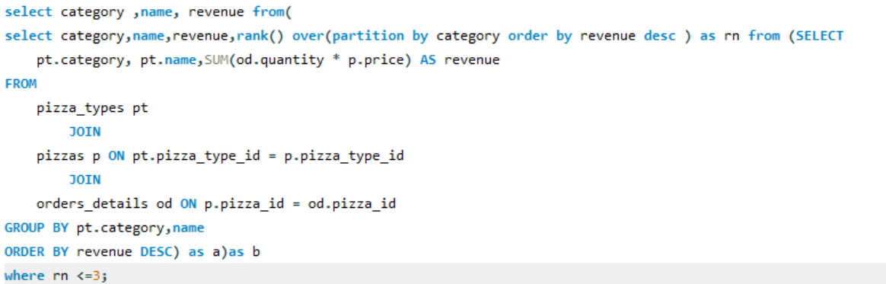
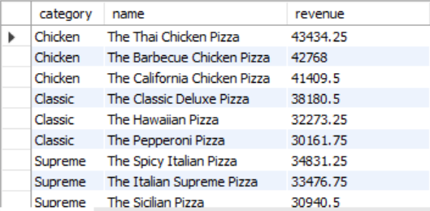
Determine the top 3 most ordered pizza types based on revenue for each pizza category.
Query:
Output:

